Slide 1

CMR COLLEGE OF ENGINEERING & TECHNOLOGY
Kandlakoya, Medchal, Hyderabad - 501401
Department of Computer Science and Engineering
CRIME ANALYSIS AND PREDICTION
Under esteemed guidance of
Mr. M.SHIVAKUMAR
(Assistant Professor)
PRESENTED BY:
M . Guru Sai Chawan-20H51A0517
T . Manohar-20H51A05D3
M . Meghana-20H51A05P5

Slide 2
Outline
Abstract
Introduction
Literature survey
Existing system
- Problems in existing system
Research Objective of Presentation
Problem Definition
Research work
- Proposed system architecture
- Methods
- Comparison of Proposed system with an existing system
Performance Measure
Results
Conclusion
Future Work
References
Notes:
2

Slide 3
Abstract
Notes:
3

Slide 4
ABSTRACT
Crime analysis and prediction is a systematic approach aimed for Identifying and addressing criminal activities by predicting high-crime areas and visualizing potential trouble spots.
This system relies on existing datasets to extract new information, serving as a valuable tool in understanding and combatting the widespread challenges posed by crimes.
From minor offenses to severe acts, crimes negatively affect quality of life, hinder economic growth, and damage a nation's reputation.
To safeguard society from these threats, advanced systems and innovative approaches are essential. There is a need to enhance crime analytics, focusing on the analysis, detection, and prediction of crime probabilities within specific regions to proactively protect communities.

Slide 5
INTRODUCTION
Notes:
5

Slide 6
Introduction
Crime is a pervasive issue in our society, demanding proactive measures for prevention. With a multitude of crimes occurring frequently, maintaining an accurate database is imperative. This database serves as a crucial resource for future reference and analysis.
The daily crime rate is rising due to criminals leveraging modern technologies. The Crime Record Bureau reports an increase in crimes like murder and sexual offenses. Data is collected from blogs, news, and websites to build a comprehensive crime report database
Machine Learning and Data mining techniques provide valuable insights for crime reduction by aiding in faster culprit identification and highlighting high-crime areas.
The proposed framework uses different visualization techniques to show the trends of crimes and various ways that can predicts the crime using machine learning algorithm and Methods.
Notes:
6

Slide 7
Literature Survey
Notes:
7

Slide 8
Existing system
SN | Problem statement | Name Of The Proposed Solution / Method | Solution | Remarks
1 | Crime Prediction And Analysis | Statistics Model | Traditional statistical models. These are used for crime prediction. These models analyse historical crime data and identify trends and patterns. | Traditional statistical models, such as regression analysis and time-series analysis, have been used for crime prediction..
2 | Crime Prediction And Analysis | Hotspot Analysis Method. | Hotspot analysis identifies areas with high crime concentrations, enabling targeted policing efforts | Hotspot analysis identifies areas with high crime concentrations, enabling targeted policing efforts
3 | Crime Prediction And Analysis | Crime Pattern Analysis Using Data Mining. | The huge data is used as a record for creating a crime record database. The crime analysis using five steps they are Data Collection, Classification, Pattern identification, prediction, and Visualization. | complexity in finding the pattern and accuracy
Notes:
8

Slide 9
Research Objective
Notes:
9

Slide 10
Research objective
The main objective of the project is to enhance this usage of Machine Learning in current situation.
There are many issues like time consuming process and some human error which can be solved by this process.
The proposed solutions saves the time which a human spend on predicting and analyze Crimes in particular cities.
We created a model which is trained with the dataset which gives the exact pictorial representations of the given crime data and hence used to analyse and predict the future Crimes.

Slide 11
Problem Definition
Notes:
11

Slide 12
Problem Definition
In this project, we will be using the technique of machine learning for crime prediction of crime data sets. It consists of crime information like location description, type of crime, date, time, latitude, longitude.
Before training the model data preprocessing will be done following this feature selection and scaling will be done so that the accuracy obtained will be high.
Here We are Using the different classical time Series forecasting Methods like AR(Auto Regression) , SARIMA(Seasonal Autoregressive Integrated Moving Average).The K-Nearest Neighbor (KNN) classification and various other algorithms (Decision Tree and Random Forest) will be tested for crime and propose one with better query-based use for training.
Visualization of the dataset will be done in terms of graphical representation of many cases, for example at which time the crime rates are high or at which month the criminal activities are high.

Slide 13
Research Work
Notes:
13

Slide 14
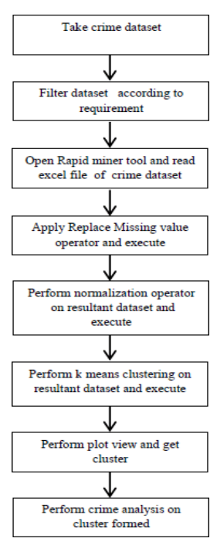
Proposed system architecture

Slide 15
Proposed Method
In this work, we will build a machine learning module. The model works on the concept of Time Series Forecasting and Clustering. After successful running of the module the analysis and the forecasting results are shown through graphs and plots. We intend to provide an analysis study by combining our findings of a particular crimes dataset with its demographics information.
Prediction process
Data gathering
Classification / Clustering
Prediction / Forcast

Slide 16
Proposed Method
A. Dataset
The crime dataset from Kaggle is rich with information such as crime location, city, time, longitude, and latitude. It's a crucial resource for our crime prediction and analysis project, allowing us to identify hotspots and trends.
B. Data Clustering
In our Crime Prediction and Analysis Project, we employ K-means clustering to identify natural clusters within the crime data based on features like location, time, and geographical coordinates. This helps uncover distinct crime patterns and hotspots, enabling law enforcement to allocate resources more effectively and predict criminal activities with greater precision. By leveraging K-means clustering, we aim to enhance community safety through targeted and efficient crime prevention strategies.

Slide 17
Proposed Method
C. Time Series Analysis
we use Time Series Analysis techniques like ARIMA and Prophet to uncover patterns in crime data over time. ARIMA identifies trends and seasonality, aiding future crime rate predictions, while Prophet captures daily, weekly, and yearly patterns for more accurate forecasts.
D. Visualization
In our Crime Visualization component, we utilize ARIMA and Prophet for advanced time series analysis of crime data, unveiling meaningful patterns over time. These insights empower law enforcement and decision-makers to allocate resources effectively for crime prevention and intervention strategies.

Slide 18
Performance Measure:
Measuring the success of a crime analysis and prediction project involves checking if it accurately predicts where crimes might happen, leading to a decrease in crime rates and quicker responses from law enforcement.
It's also important to see if it helps police allocate their resources better, solves more crimes, and keeps costs reasonable. Users should find it easy to use and helpful, while false alarms should be minimized.
Lastly, the system should be reliable and able to adapt to changes in crime patterns or growing data. By looking at these factors, we can tell if the project is making communities safer and helping law enforcement do their job effectively.

Slide 19
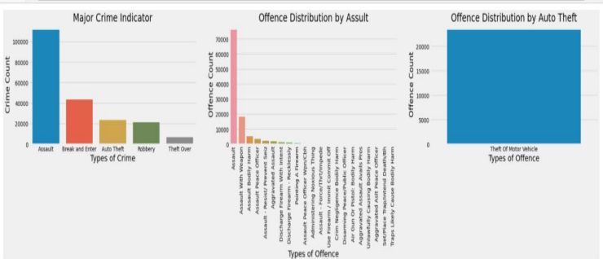
Result Analysis
Plotting and Analysis of different Crime:

Slide 20
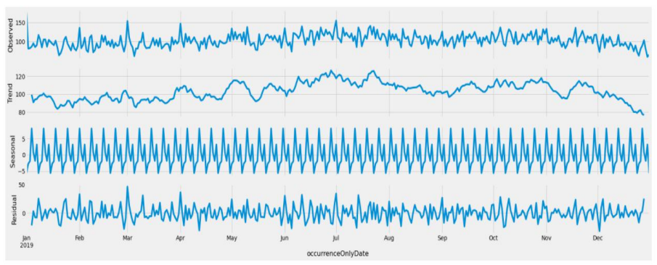
Result Analysis
Time Series Analysis for Total Crime Count:

Slide 21
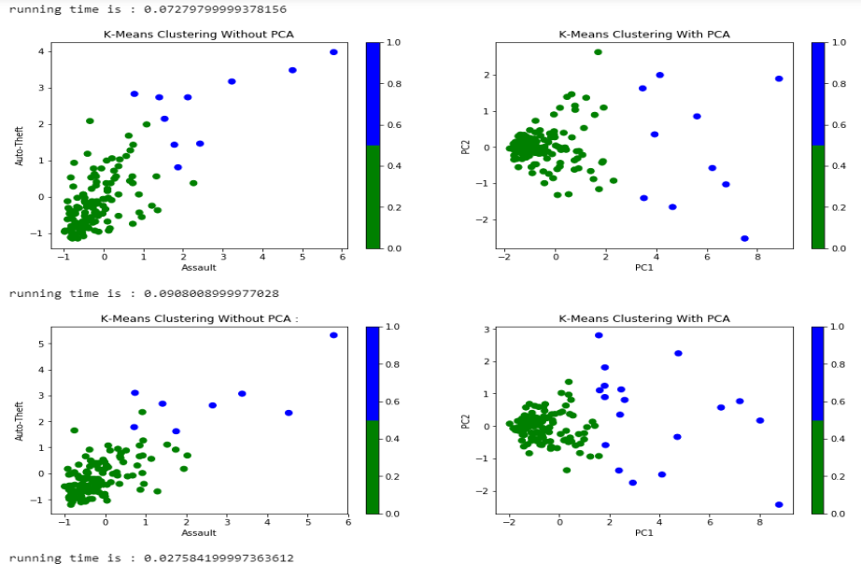
Result Analysis
K-Means Clustering:

Slide 22
Conclusion
By leveraging machine learning algorithms, we have successfully built predictive models, selecting features based on PCA and clustering outcomes. Continuous monitoring ensures the models remain accurate and adaptable to evolving crime trends.
This project not only enhances our understanding of crime patterns but also establishes a robust system for proactive decision-making and community safety. The combination of forecasting, clustering, and machine learning presents a powerful approach to address the dynamic nature of criminal activities, contributing to effective crime prevention strategies and informed law enforcement initiatives.

Slide 23
Future work
Our proposed solution can potentially help people stay away from the locations (crime hotspot)at a certain time of the day along with saving lives. On the other hand, police forces can use this solution to increase the level of crime prediction and prevention. For police resources allocation. It can help in the distribution of police at most likely crime places for any given time.
Technology is noticeable
Elimination of confusion
To help people be aware of the crimes and help the society
Interactivity
Crime forecast

Slide 24
References
https://www.researchgate.net/publication/343750790_Crime_Prediction_and_Analysis
https://www.ijcrt.org/papers/IJCRT2102057.pdf
https://ieeexplore.ieee.org/document/9245120
https://www.ijraset.com/research-paper/crime-prediction-and-analysis
Kiani, Rasoul, Siamak Mahdavi, and Amin Keshavarzi. "Analysis and prediction of crimes by clustering and classification." International Journal of Advanced Research in Artificial Intelligence 4, no. 8 (2015): 11-17.
Akansha A Chikhale, Ankita K Dhavale, Aparna P Thakre, Diksha B Herode, Nikita D Nasre, Pracheta D Patrikar, Prof. Milind Tote. “A Review on Crime Rate Analysis Using Data Mining” International Journal of Scientific Research in Science, Engineering and Technology 5, no. 5 (2019): 119 – 125.
J. Zhou, Z. Li, J. J. Ma and F. Jiang, "Exploration of the Hidden Influential Factors on Crime Activities: A Big Data Approach," in IEEE Access, vol. 8, pp. 141033141045,2020,doi:10.1109/ACCESS.2020.3 009969.

Slide 25
Thank You!

